Slide 1

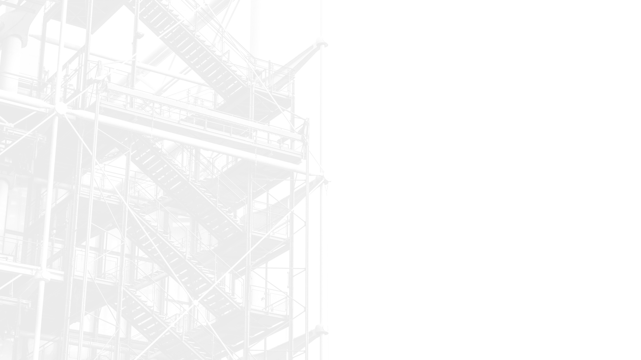

THERMO BAND
Temperature Monitoring Wristband
Design Project by
Amarathunge A.M.N.L. - 230038E
Abeywardhana.T.C.W. - 230012U
Adikari A.H.C.S. - 230017E
Peiris E.A.S.S. - 230469B
Notes:
Good evening, everyone. I am Nilesh, these are my colleagues Tharinda, Subodha and Chamod.

Slide 2
PROBLEM
In most hospitals and medical centers, there is no specific method for measuring real time body temperature periodically. Currently, temperature is measured manually using thermometers, which can be inefficient and inaccurate. We conducted a survey of nearly 70 doctors, nurses, and other medical professionals.
Notes:
After talking with few medical professionals, we found out that body temperature is one of the most important signs of being a healthy person. And abnormally high or low temperature is one of the easiest ways to diagnose diseases. But unfortunately, the current solution is to go to individual patients and use a thermometer to measure the temperature and record it manually. This process is prone to errors, and due to heavy workload nurses are under most often neglected.

Slide 3
WHAT IS THERMO BAND ?
Thermo Band is a Internet Connected Temperature monitoring
Wrist Band that continuously monitors the real-time body temperature
•Provide real-time temperature tracking
•Send alerts if the body temperature is too high or too low
•Reduce the need for manual temperature checks
•In a ward one person can monitor the temperature of whole ward at once
Notes:
The solution, ThermoBand, is a wrist band that patients can wear on their wrist. This device will periodically send temperature measurements to a server. All data of the patient will be given in an easy-to-use application that nurses can use to monitor entire wards at an instant. And with our easy-to-use application and devices, it also makes it easy for not only hospital environments, but it also makes measuring temperature in a home environment easy too.

Slide 4
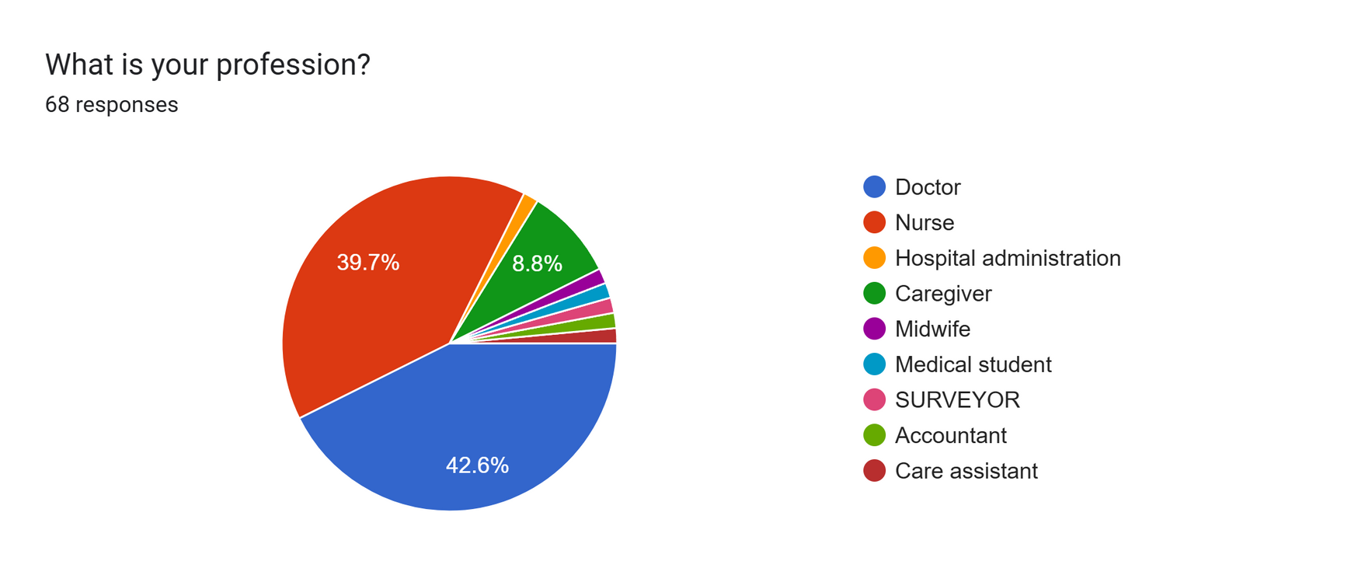
STAKEHOLDER IDENTIFICATION
We conducted a survey on this and received responses from the following professionals
Notes:
We identified our stakeholders to be mainly, doctors, nurses, other hospital staff, care givers. So, we stated that with a survey, surveying nearly 70 medical professionals, mostly consisting of doctors, nurses, caregivers and hospital staff.

Slide 5
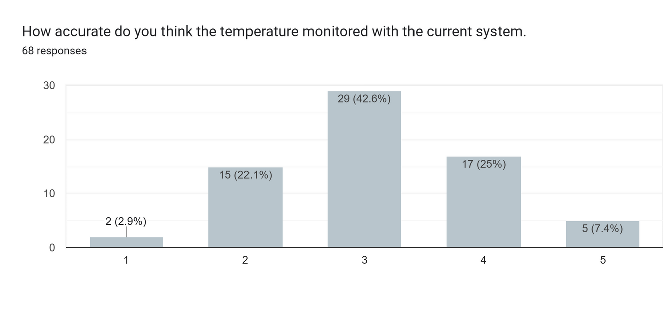
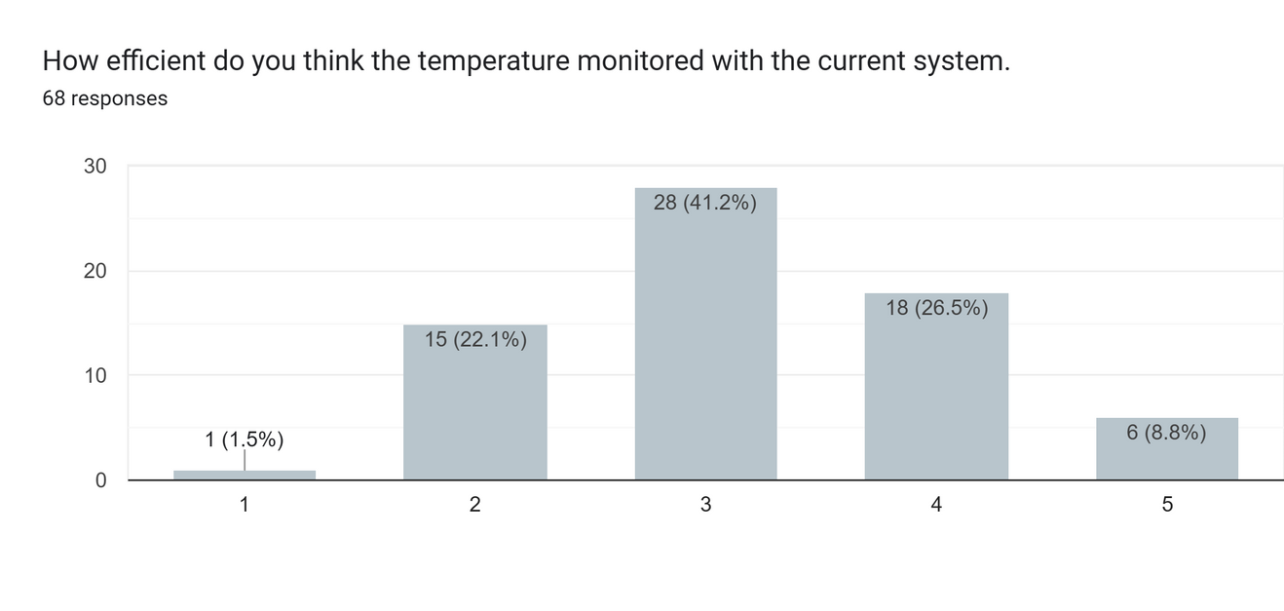
NEED FOR THERMO BAND
In our survey, we asked them about the accuracy and efficiency of the current temperature monitoring system, and the responses are as follows
Notes:
Though tis survey we found out that the current system is not very accurate or efficient. Nearly 70% of participants said that the current system is not every accurate while, 65% said the current system is very inefficient.

Slide 6
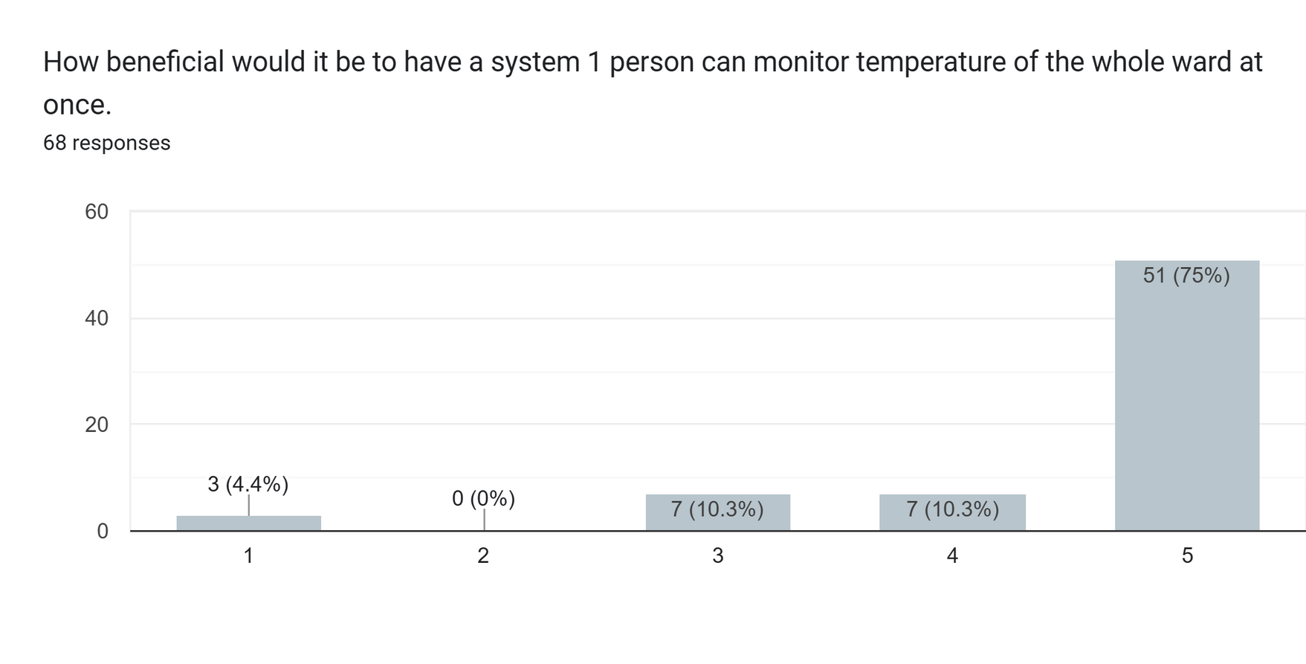
NEED FOR THERMO BAND
And also we asked them How beneficial would it be
Notes:
And 75% of them said that the ThermoBand solution will be highly beneficial to them in their day-to-day life.

Slide 7
ALTERNATIVES CONSIDERED
Manual Thermometers
✅ Commonly used in hospitals.
❌ Require frequent manual checks by medical staff.
❌ Risk of human error in reading and recording.
❌ Not suitable for continuous or remote monitoring.
❌ Inefficient in high-patient-load scenarios.
Smartwatches with Temperature Sensors
✅ Provide real-time temperature data and other health metrics.
✅ Offer wireless data sync and app connectivity.
❌ Expensive and not affordable for large-scale hospital deployment.
❌ Not specifically designed for medical-grade accuracy.
❌ Limited battery life and potential discomfort for patients
Notes:
We considered few alternative solutions. First, using higher accurate thermometers. Those it’s easy to implement and cheap, it doesn’t solve the problem of having to go to every patient to measure the temperature and the human error that comes with this solution. Secondly, as we all know there are already smart watches with temperature measuring capabilities. But these devices are mostly focused as accessories so, the measurements aren’t that accurate, and these devices come with a high price tag making them not suitable for large scale applications.

Slide 8
SOLUTION ARCHITECTURE
Thermo Band
Battery
Temperature
sensor
Backend
power
management
unit
Processing
Unit
Power input
Frontend
Power
Switch
LED indicator
Notes:
Moving one to solution architecture, we have mainly 2 components, the device itself and the application. For the device power is supplied by the USB type C port, power management unit is responsible for charging the built-in battery and all the power and protection of the circuits. The processing unit equipped with an ESP8266 12F chip for its low power performance and built in wireless capabilities handles all the data gathering and pushing data to servers. And we are using a DS18B20 digital temperature sensor for its great precision and digital communication. Finally, we have a backend and the frontend application which users will interact with.

Slide 9
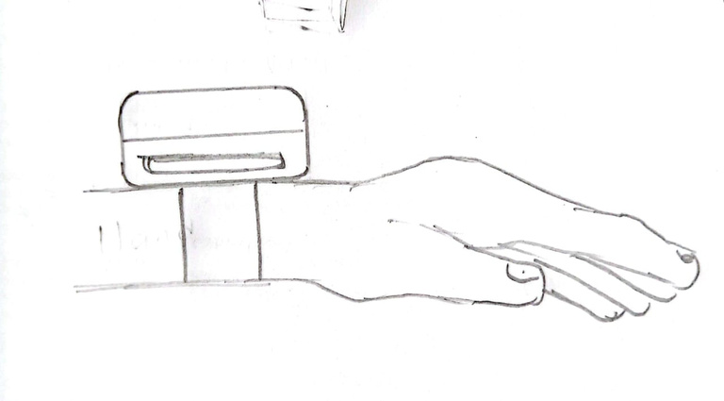
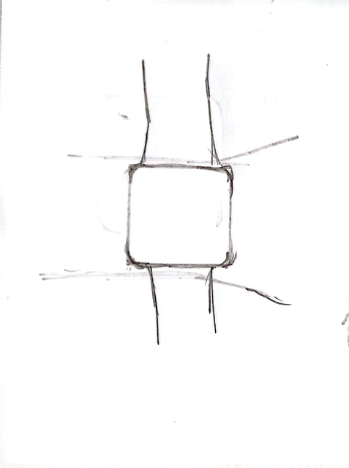
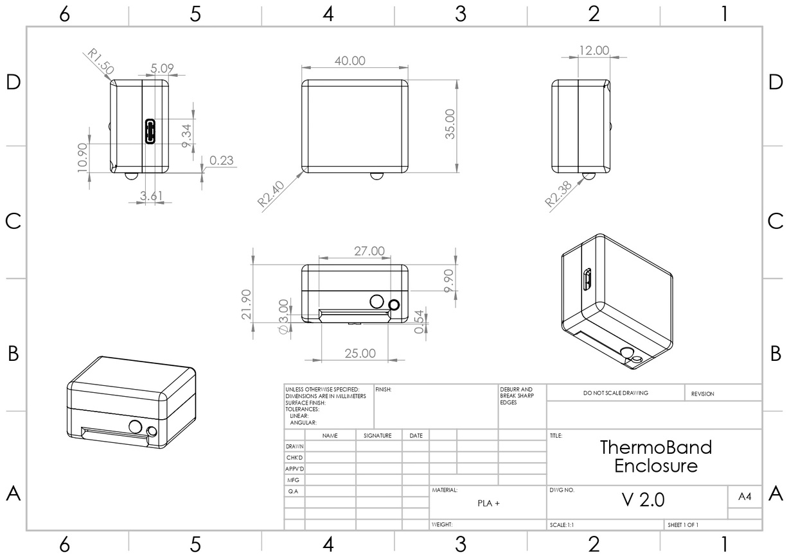
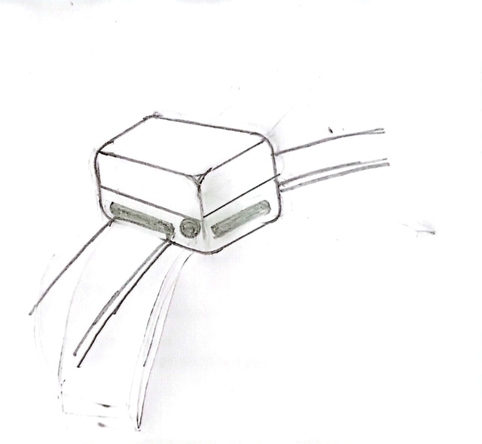
SKETCHES
Notes:
These are few of our initial sketches for ThermoBand Device. And as you can see the right side is our final design drawing for the device. Here is our device with a complete 3D view. Users will have a power button to turn on and off the device and the device will have a LED indicator to indicate the status of the device.

Slide 10
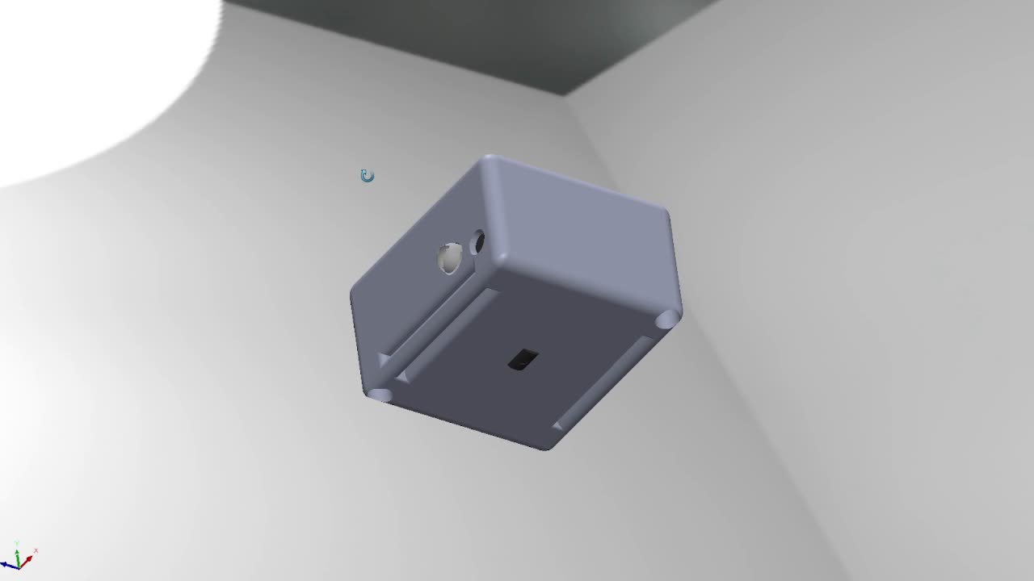
FINAL DESIGN
Notes:
These are few of our initial sketches for ThermoBand Device. And as you can see the right side is our final design drawing for the device. Here is our device with a complete 3D view. Users will have a power button to turn on and off the device and the device will have a LED indicator to indicate the status of the device.

Slide 11
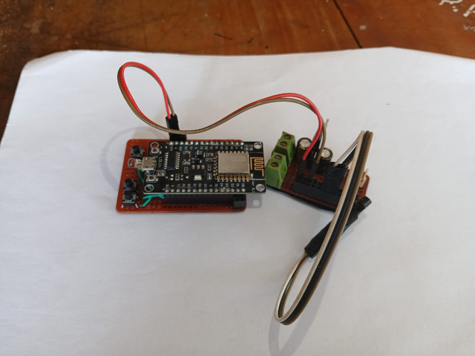
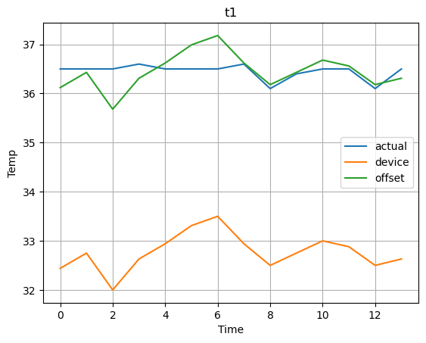
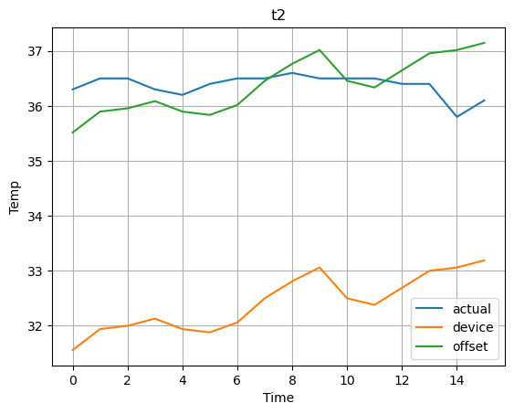
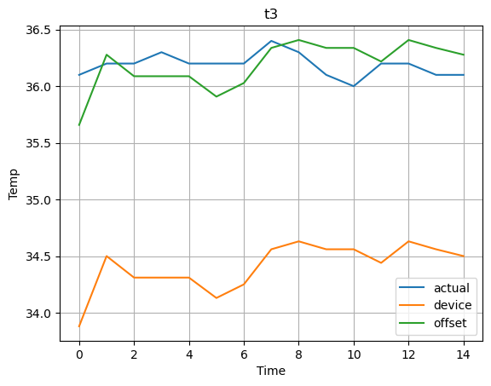
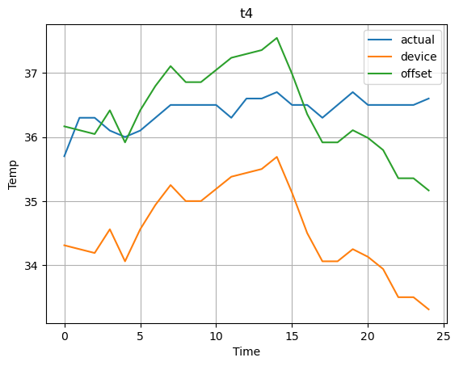
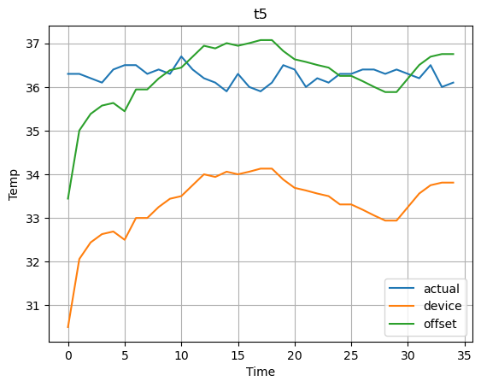
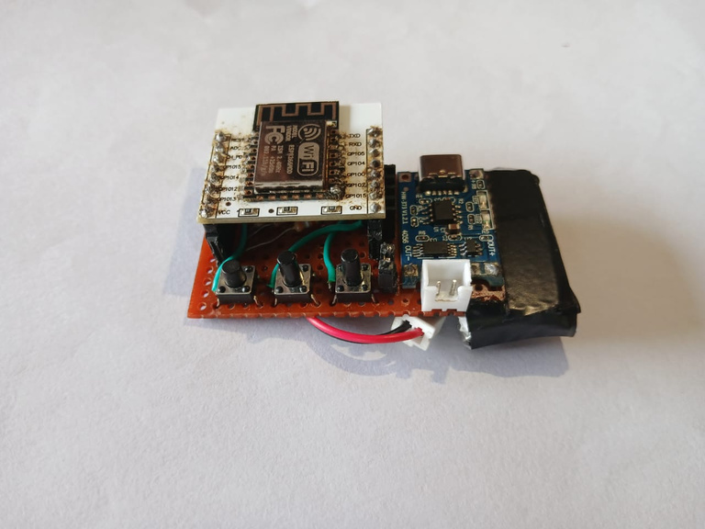
RESULTS UP TO NOW
Prototype 01
Prototype 02
Notes:
Speaking of project progression, we created 2 initial prototypes to validate the idea and to finalize the components for the device. And we finished the initial testing and calibration of the device. As you can see from the graph our measurements done by our product have a very good correction to the actual core body temperature. And now we are moved on to PCB manufacturing and testing and we are currently in the implementation stage. After that we will move on to testing the product in the field.

Slide 12
CHALLENGES FACED
Size Constraints
Designing a compact, user-friendly enclosure that fits both the PCB and all required components was a significant challenge. We needed to balance ergonomics with internal hardware space.
Solution: We adopted a modular design approach, using 3D modeling tools to create a custom enclosure that fits the PCB precisely while ensuring comfort for users. Multiple iterations and prototype prints helped us refine the form factor.
Battery Capacity vs. Size
Finding a battery that offers high capacity while maintaining a small physical size was difficult, as most compact batteries have limited power storage.
Solution: After evaluating several options, we selected a lithium-polymer battery that offers an optimal balance between capacity and size. We also optimized the firmware for energy efficiency, extending operational time between charges.
Notes:
Main challenges we faced during the development, as for any wearable device is the size constraint. To make the device comfortable to wear and easy to manage we found that the device must be small. So, to overcome this challenge we had to go with SMD components and even had to design a 4-layer PCB to fit all the components. Secondly, the battery size was another challenge we faced. For the device to be useful the device must have a good enough battery life to be usable, but with the size it was very hard to find small enough batteries with good enough capacities.

Slide 13
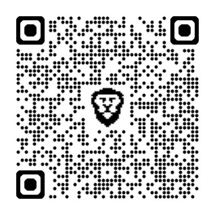
Q/A
Survey Data
https://docs.google.com/spreadsheets/d/1vOMyJXLqMs5noxcNcRK0KVpRrKSHznhZ65DRKLxjSkI/edit?usp=sharing
Research Papers
https://pmc.ncbi.nlm.nih.gov/articles/PMC1752199/
https://www.mdpi.com/1424-8220/24/6/1944
Project Files
https://github.com/NileshAm/ThermoBand-EN1190
Notes:
So, that’s it for the presentation, survey data and project files can be found on these URLs. Any questions?

